Slide 1
Bake Off 1 - Team 10
By Giuseppe Schintu and Patrick Kay

Slide 2
Initial Ideas
Make the button Flash
Give Directions before the Games start
Give the button an outline
Tie each button to a Keyboard key
Create a boundary keep the mouse within the 4x4 area

Slide 3
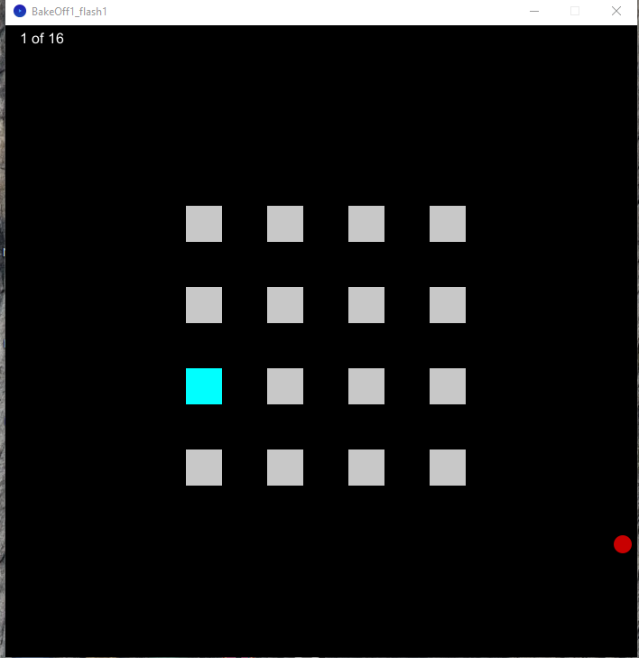
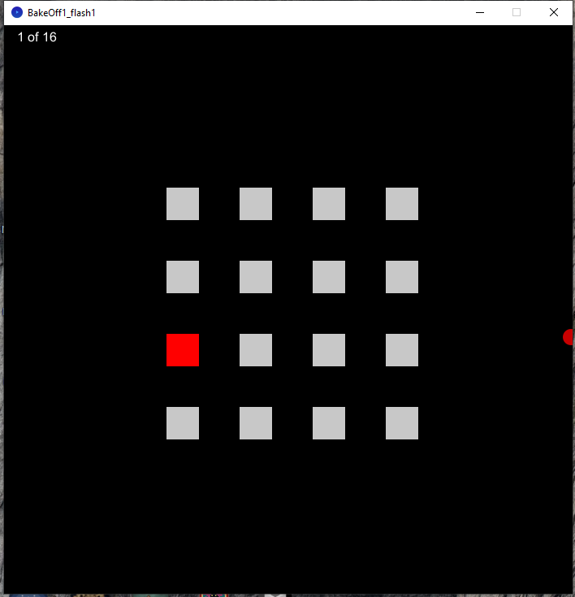
1st Prototype - Flashing Button

Slide 4
Flashing Button Process
Tried different Colors for the on/off flashing
Tried to find the most Eye-catching colors
Studies have found that Red and shades of Red are the most Eye catching colors
Settled on Cyan and Red
Set the Colors to alternate every six seconds

Slide 5
1st Testing
Times | Repeats = 1 | Repeats = 2 | Repeats = 3
Original | 12.297 Seconds | 26.019 Seconds | 38.497 Seconds
With Flashing | 12.048 Seconds | 24.169 Seconds | 35.133 Seconds

Slide 6
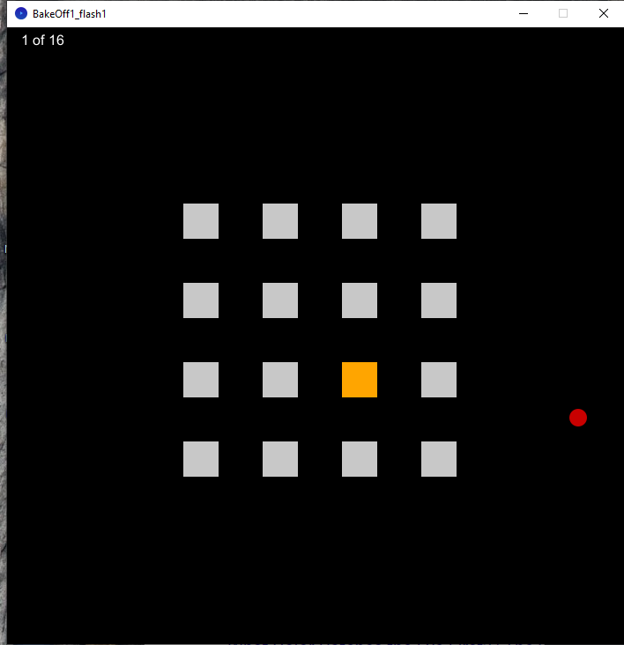
1st Refinement
Times | Repeats = 1 | Repeats = 2 | Repeats = 3
Original | 12.297 Seconds | 26.019 Seconds | 38.497 Seconds
With Flashing Cyan/Red | 12.048 Seconds | 24.169 Seconds | 35.133 Seconds
With Flashing Orange/Red | 11.867 Seconds | 22.749 Seconds | 34.733 Seconds

Slide 7
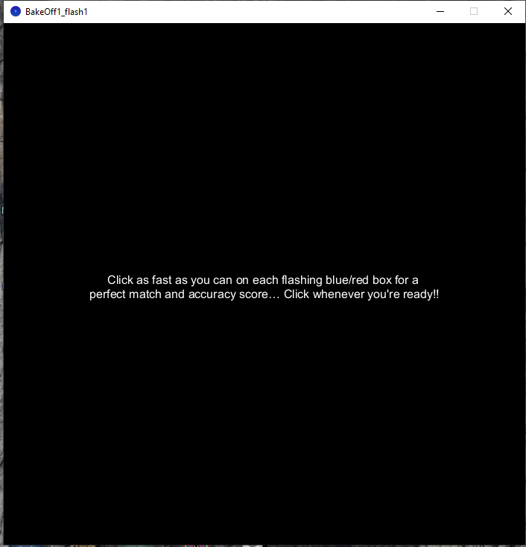
2nd Prototype - Give Instruction
After a couple rounds of testing, we realized that we were becoming better at the game.
To counteract this we wanted to prepare testers who were unfamiliar with the game.
This also seemed a good way for the tester to get their mouse into a good position.

Slide 8
2nd Testing W/ Testers
Times | Repeats = 1 | Repeats = 2 | Repeats = 3
Original | 13.368 Seconds | 28.018 Seconds | 37.982 Seconds
With Flashing Orange/Red | 12.612 Seconds | 24.854 Seconds | 35.363 Seconds
With Instruction | 12.001 Seconds | 21.268 Seconds | 34.265 Seconds

Slide 9
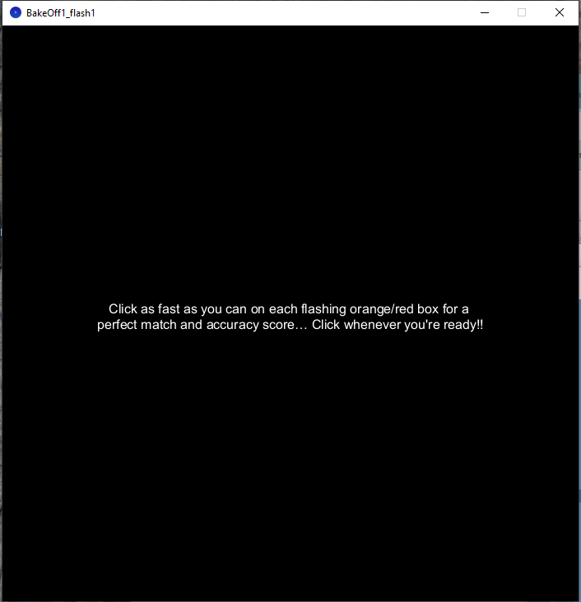
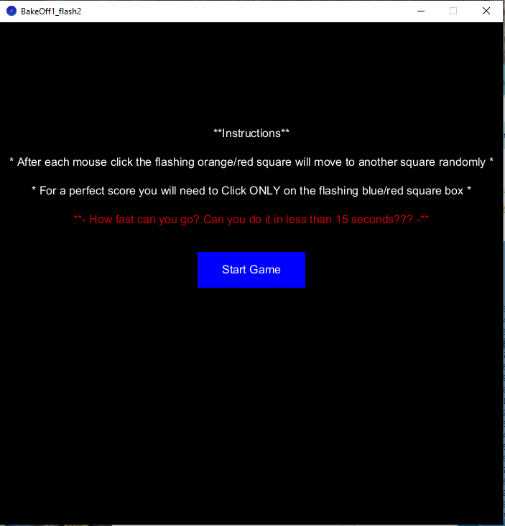
Final Refinement

Slide 10
Final Prototype
Times | Repeats = 1 | Repeats = 2 | Repeats = 3
With Start Game Button | 11.955 Seconds | 23.015 Seconds | 34.567 Seconds
“ Adding instructions, red challenge phrase, and a Start Game button ensures players know what to do, try to stay below the 15 seconds, and ensure that no accidental clicks start the game, unless click happens in the ‘Start Game’ button boundary.”

